Slide 1
Contact and Non-Contact Forces

Slide 2
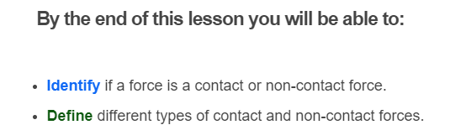
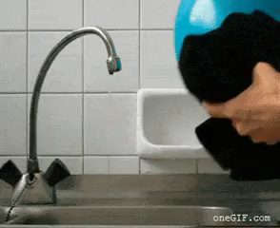

Slide 3
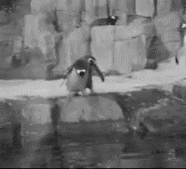
There are many different types of forces.
These forces can be split into two different categories: non-contact and contact forces.

Slide 4

Contact forces require one object to touch another.
For example, when you hit a ball with a cricket bat, the force exerted on the ball is a result of the cricket bat being in contact with the ball.

Slide 5
Non-contact forces act without the objects touching.
Gravity is a non-contact force, as it does not require contact between two objects.
For example, when you toss a coin into the air it rises to a certain height and then begins to accelerate toward the ground as it falls. The coin has a change in motion. Therefore, there must be a force acting on it, even though it is not in contact with anything. That force is called gravity.

Slide 6
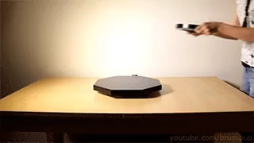
Three types of non-contact forces are...
gravitational force
magnetic force
electrostatic force

Slide 7
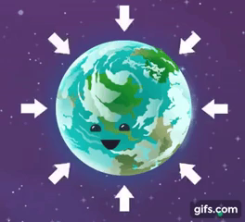
If you drop something, it falls down instead of up. This is because of gravity!
Gravitational force is the force due to gravity. It keeps you bound to the surface of the Earth.

Slide 8
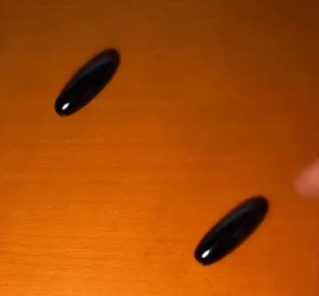
A magnetic force is the force of a magnet pulling on some metallic objects.
It can also push (repel) two magnets apart.

Slide 9

An electrostatic force is a force exerted between electrically charged objects.
It causes your hair to stand up when you rub a balloon against it!

Slide 10

Friction is an example of a contact force because it requires the object to be touching something else.
It always acts in an opposite direction to motion.
Friction is present with all surfaces. However, the rougher a surface is, the greater the frictional force.

Slide 11
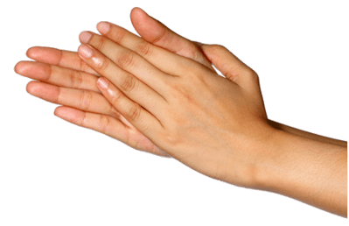
If you rub your hands together very fast, you can feel the friction between them!
It is caused by two surfaces rubbing against each other, or one object rubbing against a rough surface. Your hands get hot as a result. Give it a try and see friction in action!

Slide 12
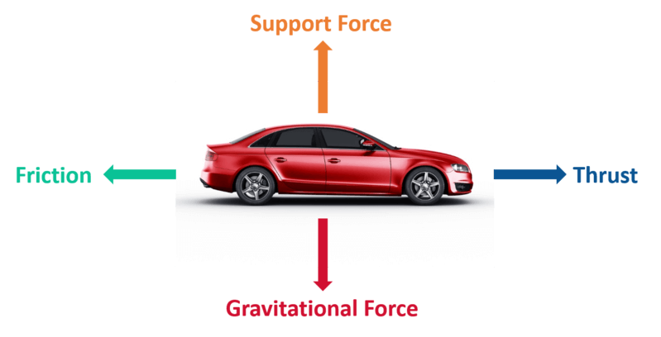
Cars are a great example for summarising the different forces:
Gravitational force is a non-contact force. We know this because gravity would still act on the car if it was hanging in the air without touching anything.
Support force is a contact force. This is because it only acts when the car is touching the ground.

Slide 13
What other forces are working on the car?
Friction is another contact force acting on the car. It occurs where the car's tyres make contact with the road. Another form of friction is air resistance, which occurs when air makes contact with the car.
Thrust is slightly more complicated so we won't worry about it too much, but it is generated by the engine of the car and pushes the car forwards.

